Slide 1
Project Terra
Arbor Animalia

Slide 2
User Interface

Slide 3
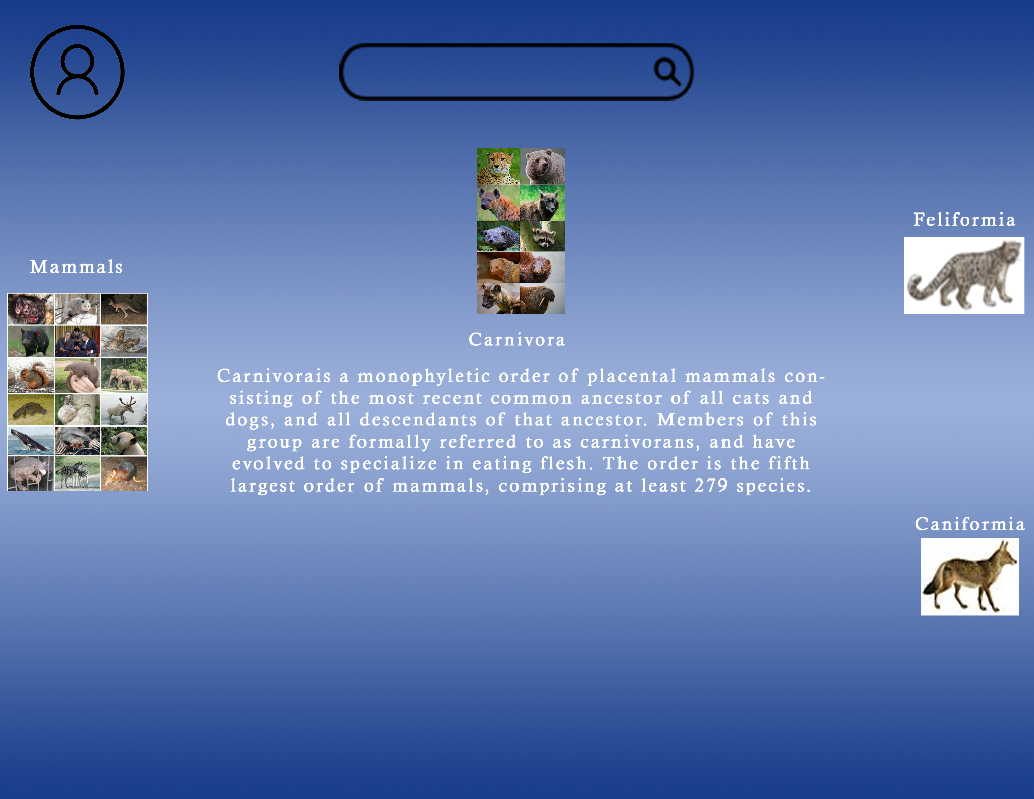
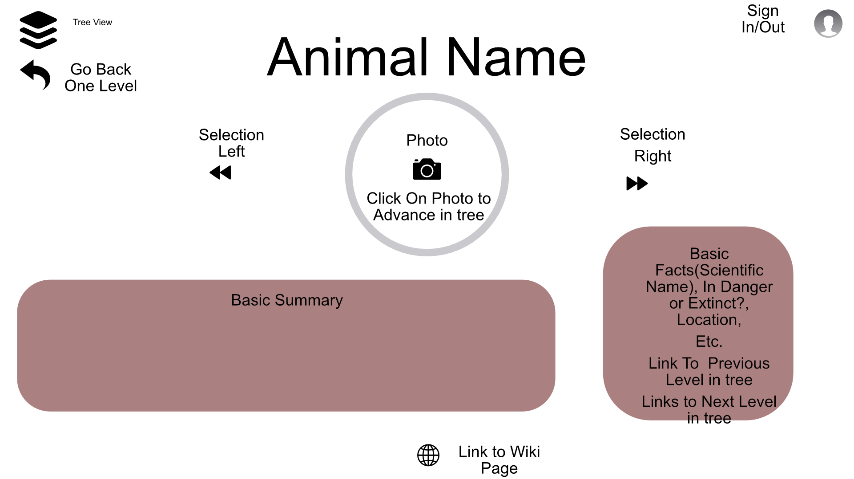
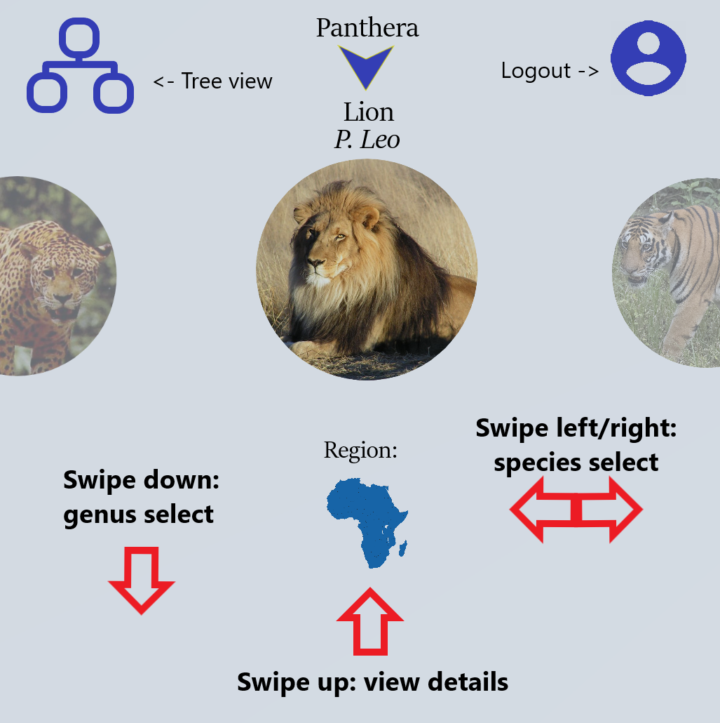
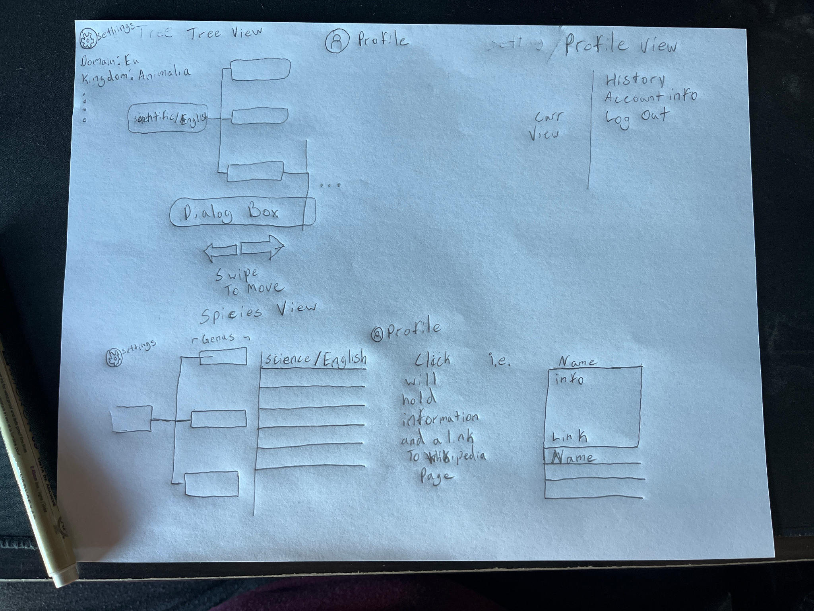
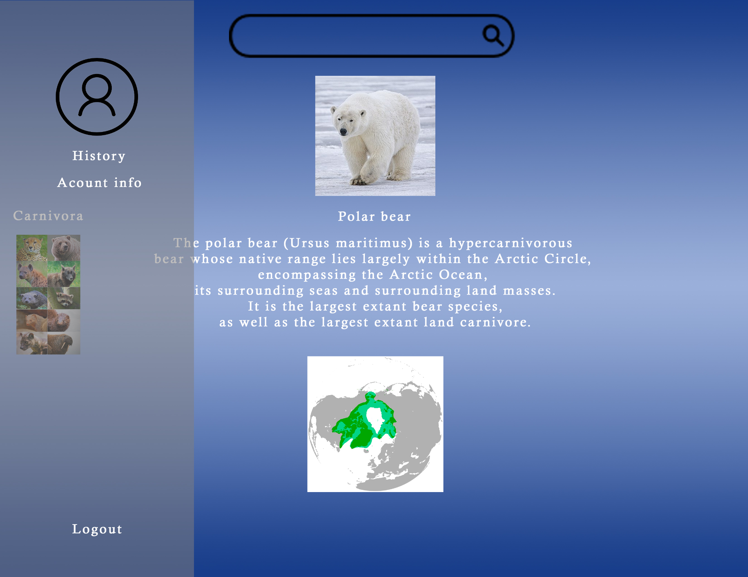
Interface Design

Slide 4
Interaction

Slide 5
User Operation
Implemented for mobile devices
Uses touch screen system to function
Swiping & Buttons

Slide 6
Login System

Slide 7
Login Info
The Login has been fully completed and now only requires implementation
It utilizes Google Email

Slide 8
System Architecture

Slide 9
The System
Services
Unity
Tree Of Life Project Database
Wikipedia API
The Backend to access the TOL database has been fully constructed and only needs to be implemented into the main program
Next step is Constructing the WikipediaService.

